Slide 1
Category plans
procurement simplified Template April 2026

Slide 2
We will target in-year cost savings and cost avoidance of $5 million
Procurement category | Category strategy | 2025 baseline spend | 2026 savings target
Transport | Mitigate carrier price risk Collaborate with group on unconstrained allocation plan | $250M | $40M
Internet & communication services | Lead RFPs for any new tech capabilities Drive savings from renewals Consolidate group capabilities | $100M | $10M
Facility services | Consolidate and centralize key services Standardize equipment Establish multiple qualified vendors | $100M | $5M
Corporate services | Mitigate temp labor price risk Lead RFPs and large renewals | $30M | $2M

Slide 3
Transport: we will target $40 million impact
Projects | Start date | Target end date | Baseline spend | Annual savings or avoidance
RFP to determine carriers for: Express and economy service Less than 1lb Other weight and service categories | Jan 2026 | Jun 2026 | $250M | $40M
Zone skipping | Jul 2026 | Dec 2026 | $250M | $5M
Cross-border volume, mostly directed to group company | Jan 2026 | Jun 2026 | $20M | Nil
Canada volume, mostly directed to group company | Jan 2026 | Jun 2026 | $20M | Nil
Onboard vendors for drayage | Jul 2026 | Dec 2026 | N/A | Nil
Quarterly business reviews | Start date
Carrier 1 | Jul 2026
Carrier 2 | Jul 2026
Carrier 3 | Jul 2026

Slide 4
Technology: we will target $10 million impact
Projects | Start date | Target end date | Baseline spend | Annual savings or avoidance
End-of-life scanner replacement RFQ | Dec 2025 | Apr 2026 | $4M | $2M
Data center server refresh and firewall upgrade | Jan 2026 | Feb 2026 | $6M | $1M
Project management software renewal | Nov 2025 | Mar 2026 | $800K | $200K
Network security RFP | Feb 2026 | May 2026 | $400K | $200K
Customer analytics software RFP | Jan 2026 | May 2026 | $3M | $100K
Quarterly business reviews | Start date
Vendor 1 | Apr 2026
Vendor 2 | Apr 2026
Vendor 3 | Apr 2026
Full list of renewals is managed separately in Excel in collaboration with finance and tech, and also used for CRC approvals

Slide 5
Facilities: we will target $5 million impact
Projects | Start date | Target end date | Baseline spend | Annual savings or avoidance
Yard Management Services – Indy | Feb 2026 | Apr 2026 | $3.9M | $800k
Security Services RFP | Jul 2026 | Oct 2026 | $6.2M | $500k
General Contractor T&Cs | Jul 2026 | Oct 2026 | $2.9M | $500k
Cleaning In-sourcing | Jul 2026 | Oct 2026 | $3.0M | $300k
Uline & Grainger e-catalogs | Feb 2026 | Apr 2026 | $2.7M | $150k
Storage Solutions RFP | Feb 2026 | Apr 2026 | $1.9M | $150k
Waste Management RFP | Oct 2025 | Feb 2026 | $550k | $50k
Janitorial supplies | Oct 2025 | Feb 2026 | $400k | $20k
Pallets | Oct 2025 | Feb 2026 | $100k | $20k

Slide 6
Corporate services: we will target $2 million impact
Projects | Start date | Target end date | Baseline spend | Annual savings or avoidance
Contingent Labor RfQ | Feb 2026 | Jul 2026 | $20M | $2M
Payroll RFP | Nov 2025 | Jan 2026 | $800K | $200K
Time & Attendance RFP & ADP Renewal | Nov 2025 | Mar 2026 | $450K | $100K
Labor Management System RFP | Apr 2026 | Jul 2026 | NA | $100K
Blackline Renewal | Sep 2026 | Dec 2026 | $309K | $50K
Material Handling Equipment Validation (Conveyor belts, sorters & racking) | Mar 2026 | Sep 2026 | TBD | TBD
Quarterly business reviews | Start date
Temp agency 1 | Jan 2026
Temp agency 2 | Jan 2026
Temp agency 3 | Jan 2026

Slide 7
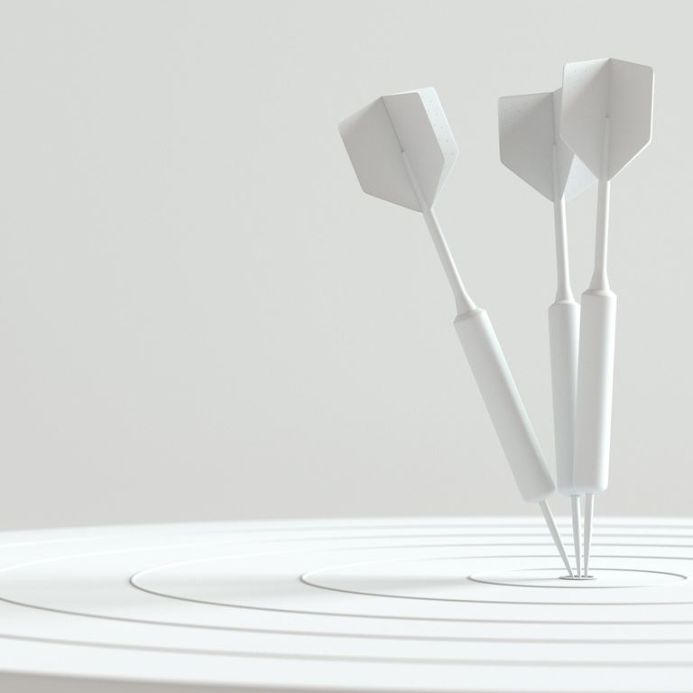
Thank you
procurement simplified April 2026

